Slide 1






FACE MASK DETECTION
Black Belts
Abdulaziz Otaif Mohammed Alhaddad Elham AlGhamdi
Reem Alsabti Esraa AlZahrani Norah Jadkarim

Slide 2

Automated Mask Detection
Definition :
The automated task of identifying whether an individual is wearing a face mask or not.
Importance:
With the recent pandemic, face masks were mandatory in most public facilities to limit the spread of the Covid virus. Thus, automated mask detectors were in high demand to enforce this policy.
Constraint:
they must identify all faces regardless of age or race
they need to identify various types and colors of face masks
they need to function in Real-time

Slide 3
YOLOv7
Yolov7 (You Only Look Once version 7) is a real-time object detector currently revolutionizing the computer vision industry with its incredible features.
The official YOLOv7 provides unbelievable speed and accuracy compared to its previous versions. YOLOv7 weights are trained from scratch using the COCO dataset.
The model can perform real-time object detection for images and videos. It can be utilized directly or through a fine-tuning process.

Slide 4
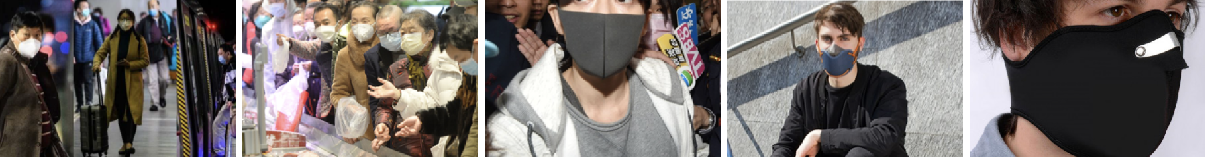
Dataset
Classes
With Mask
Without Mask
Mask Worn Incorrectly

Slide 5
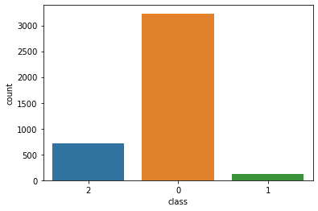
Dataset
Dataset size
4,072 images
With Mask 79%
Without Mask 17%
Mask Worn Incorrectly 3%

Slide 6
Preprocessing
Splitted the dataset into:
Train: 90%
Validation: 3%
Test: 7%
Resized images to:
Width: 640
Height: 480
Convert annotations from XML to txt

Slide 7
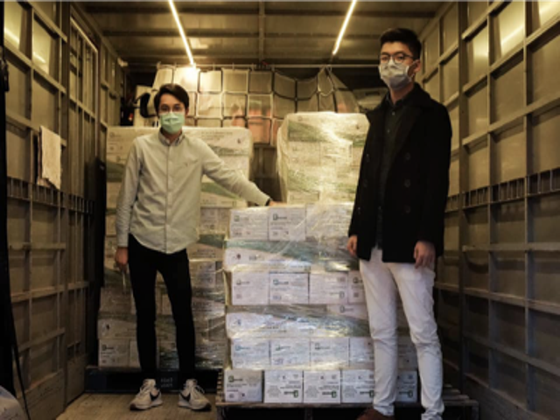
Dataset After Preprocessing
Image:
Annotation:
0 0.30625 0.2808988764044944 0.05249999999999999 0.08239700374531835
0 0.71125 0.16853932584269665 0.06749999999999998 0.09737827715355805

Slide 8
Model Training
01
03
Pretrained Model: YOLOv7x
Batch Size: 2
02
04
Image Size: 640
50 Epochs

Slide 9
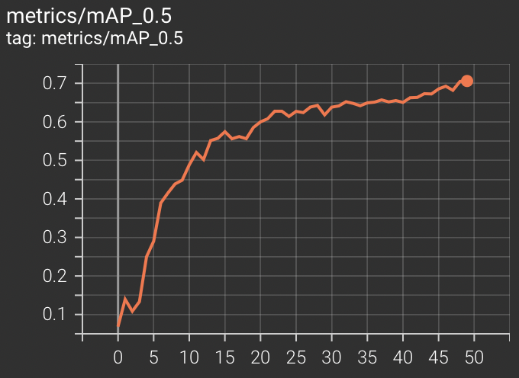
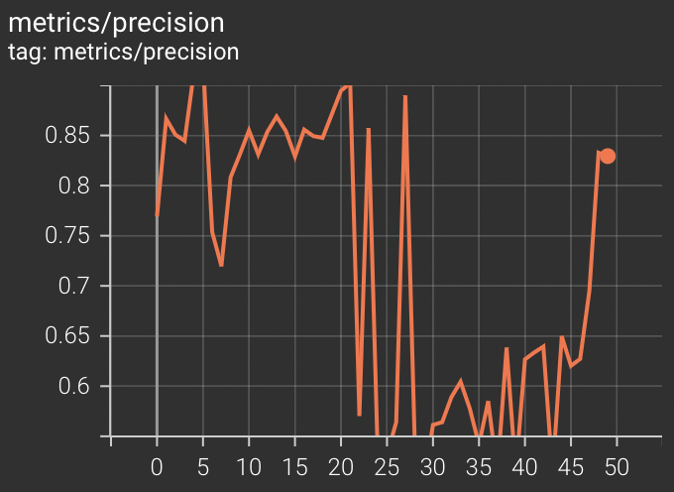
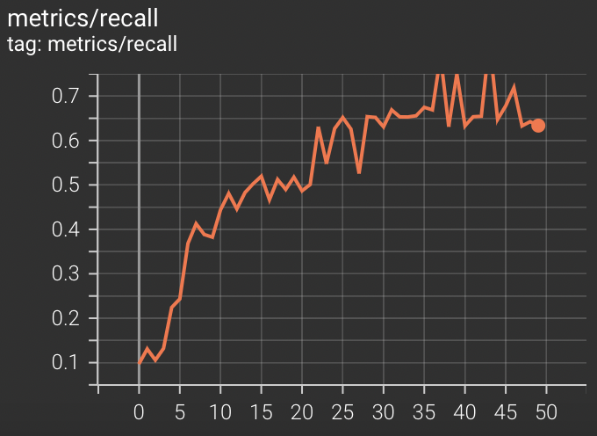
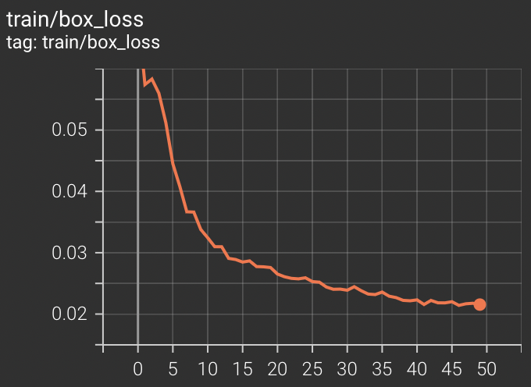
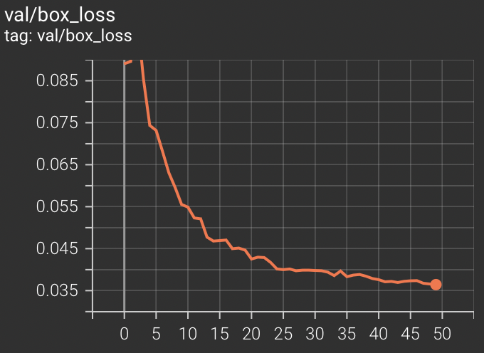
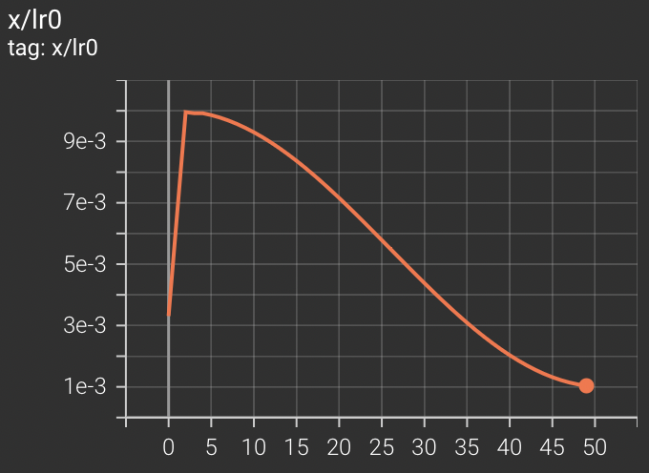
Model Training

Slide 10
Evaluation: Performance Metrics
Precision Recall Mean Average Precision(mAP@0.5)
All classes: 0.828 0.633 0.705
with_mask : 0.845 0.942 0.969
mask_weared_incorrect : 0.956 0.214 0.397
without_mask: 0.681 0.744 0.75

Slide 11
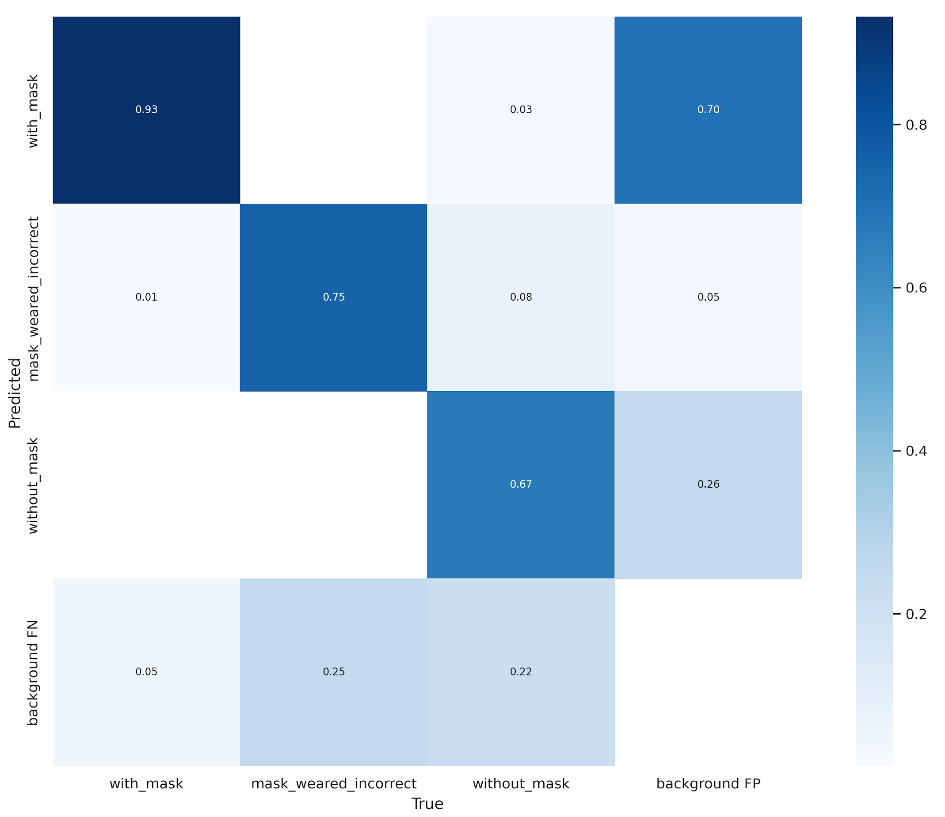
Evaluation: Confusion Matrix

Slide 12
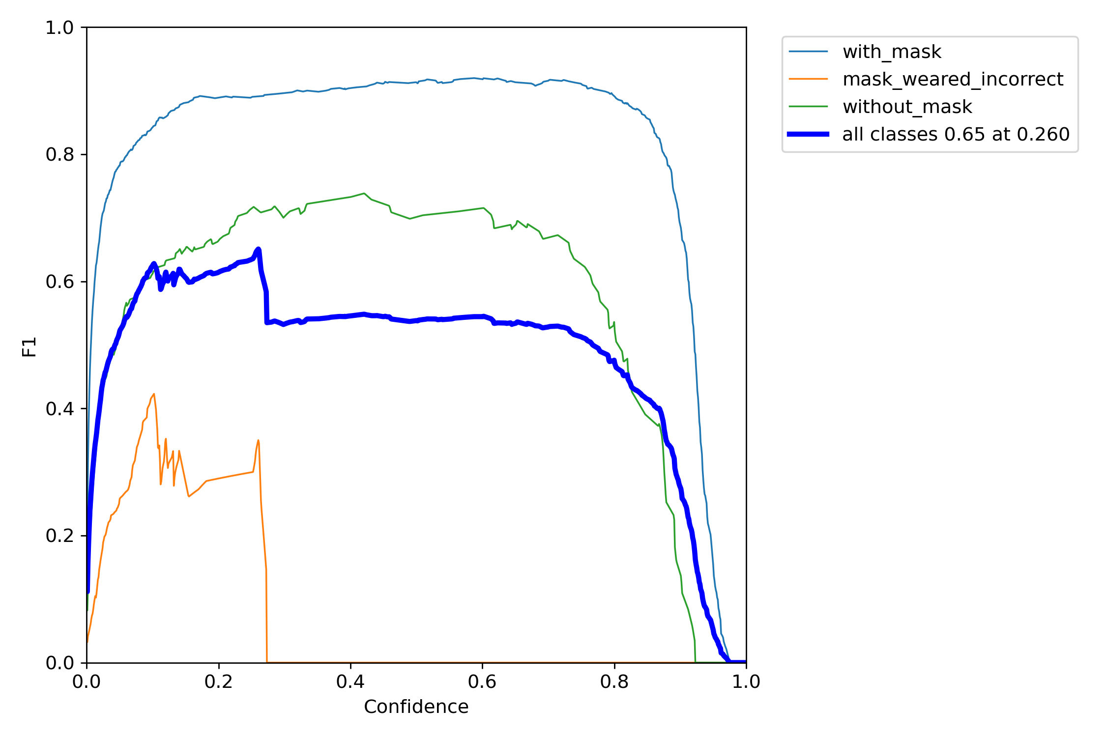
Evaluation: F1 Curve

Slide 13
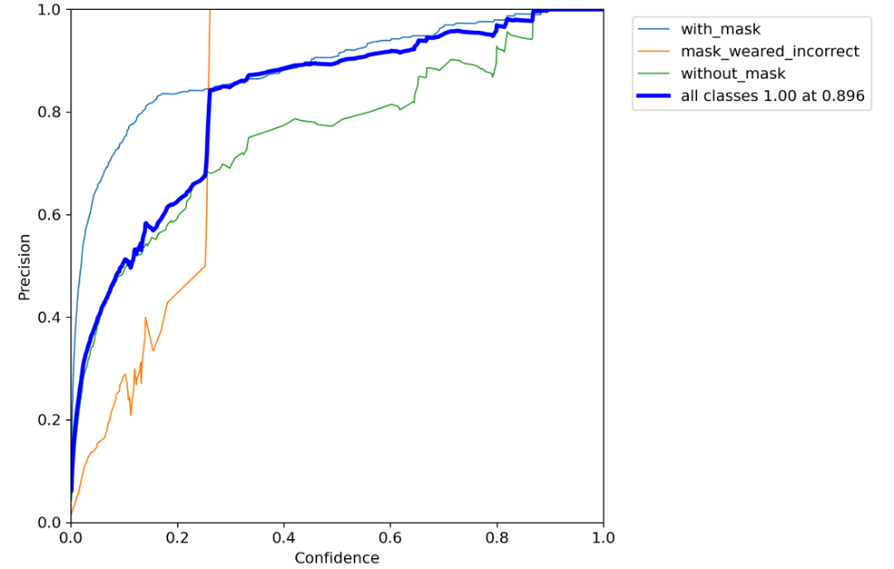
Evaluation: Precision Curve

Slide 14
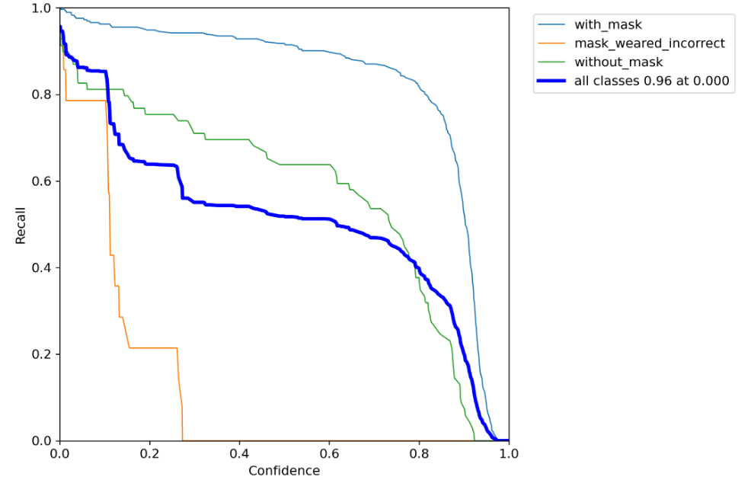
Evaluation: Recall Curve

Slide 15
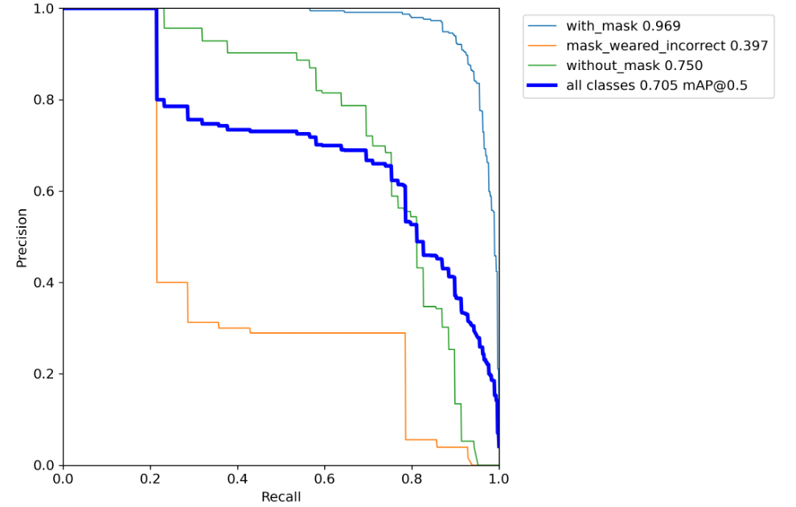
Evaluation: Precision Recall Curve

Slide 16
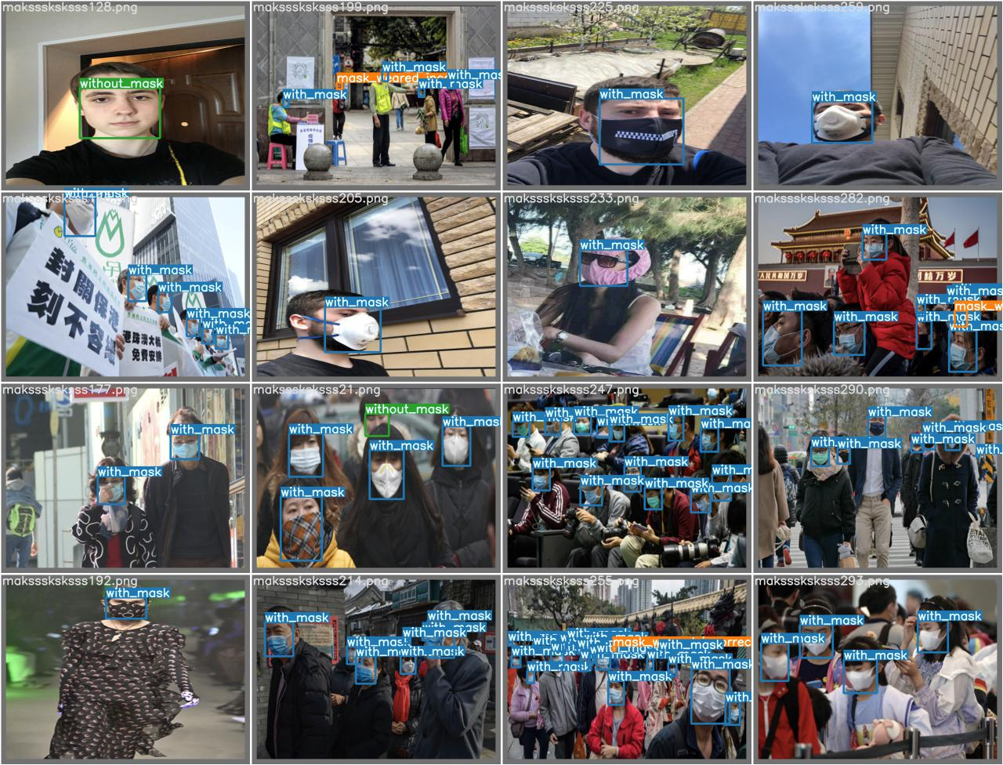
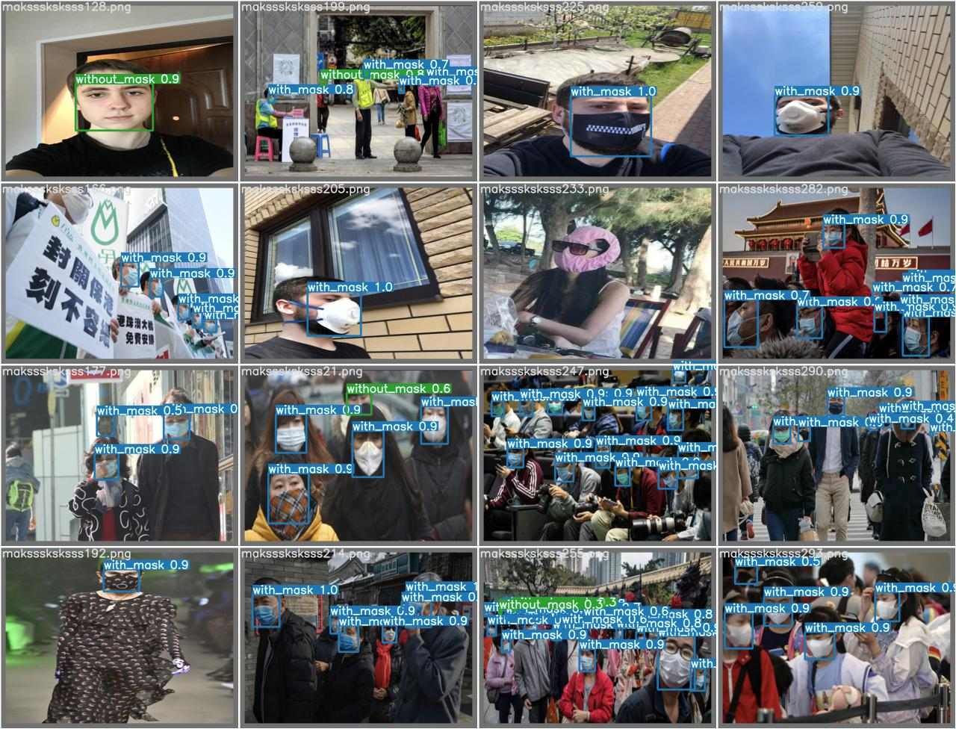
Testing Samples
True Labels
Predicted Labels

Slide 17
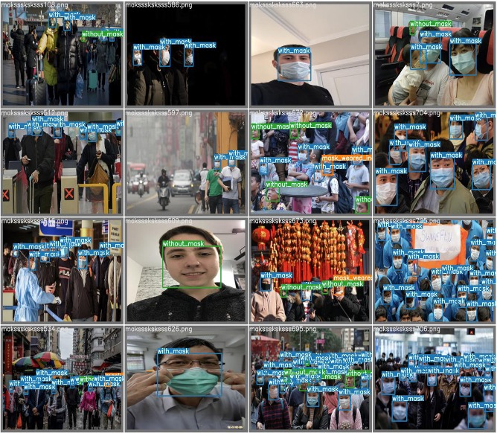

Testing Samples
True Labels
Predicted Labels

Slide 18
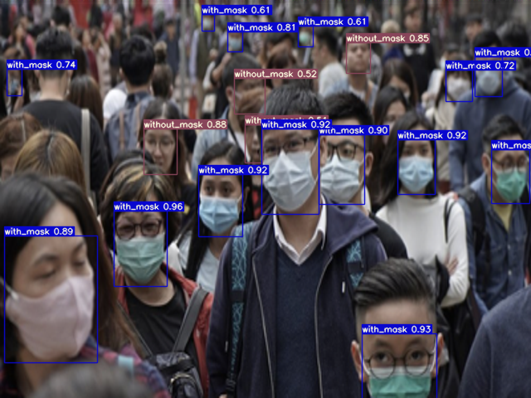
Testing Samples

Slide 19




Thanks!
Any Questions ?

